Slide 1
Cataract Prediction
CS677 Term Project
Vaidehi Shah
U90080562

Slide 2
DATASET
The “Ocular Disease Recognition” dataset has been taken up from Kaggle.
Link to dataset: ocular disease recognition
It has images of around 5000 patients with age, color fundus photographs from left and right eyes and the doctor’s diagnostic keywords. They classify patient into 8 labels including:
Normal (N),
Diabetes (D),
Glaucoma (G),
Cataract (C),
Age related Macular Degeneration (A),
Hypertension (H),
Pathological Myopia (M),
Other diseases/abnormalities (O)
I have used the dataset to make predictions for Cataract using CNN (Convolutional Neural Network).

Slide 3
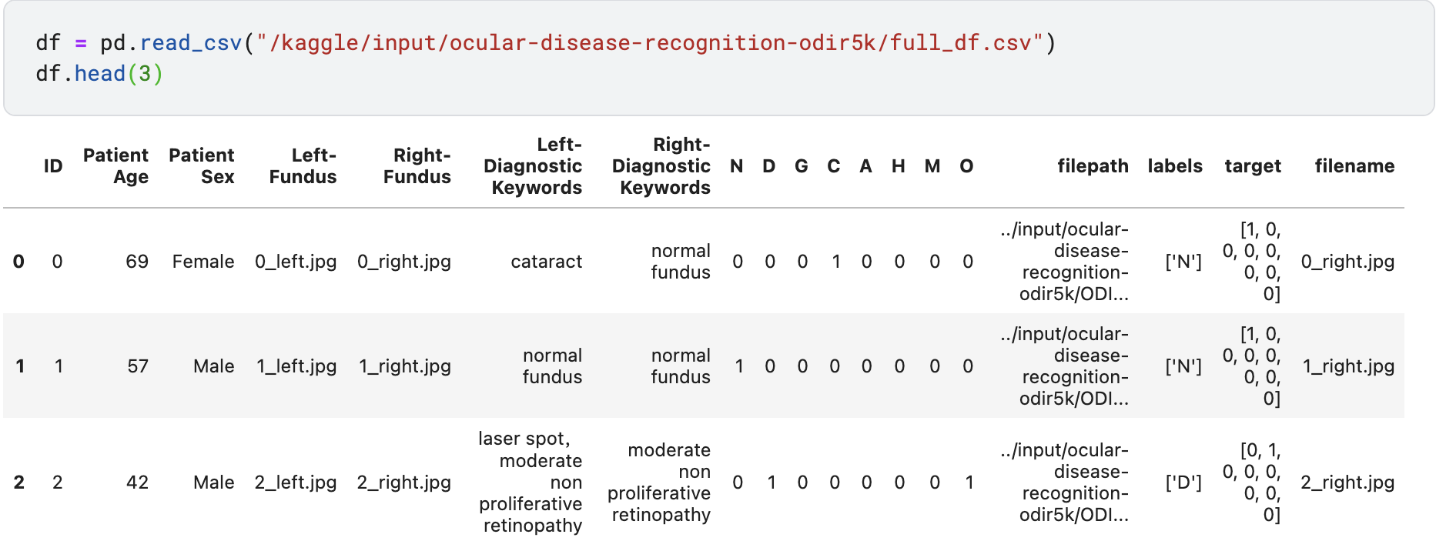
CODE IMPLEMENTATION
After loading the required libraries, I loaded the data into a dataframe named “df”.

Slide 4
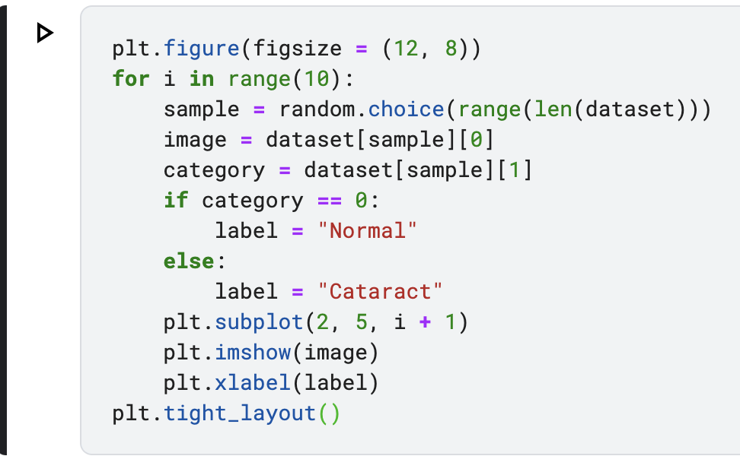
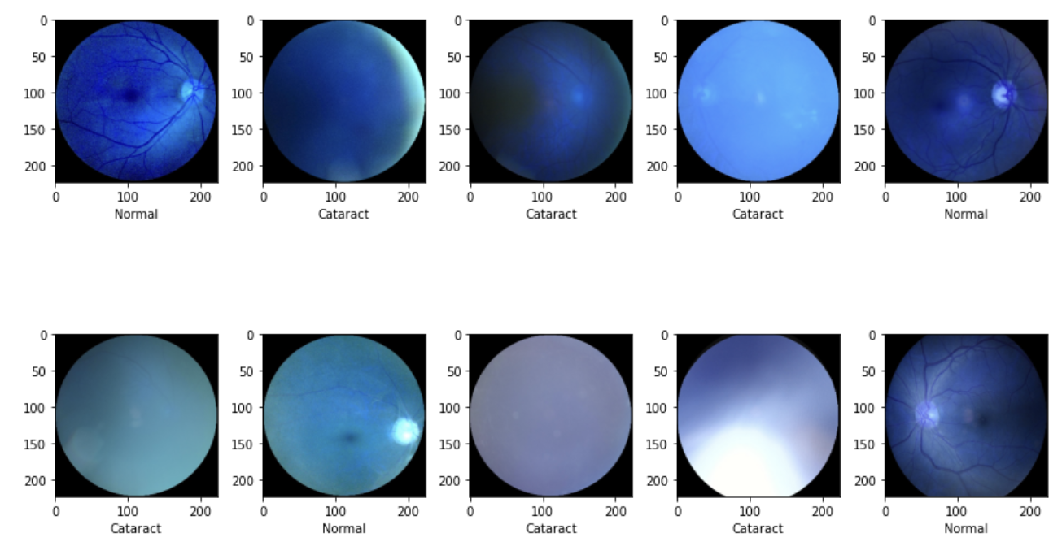
2. From the dataframe (dataset), I extracted the images associated with cataract and normal vision. For segregating (differentiating) the cataract images from normal images, I used the “C” feature of the dataset (which represents the diagnostic of having Cataract) and also the “Diagnostic keywords” of the image (which contains “Cataract” in case of Cataract and “Normal Fundus” in case of “Normal”). Cataract images: “C” = 1 and Diagnostic keywords contain “Cataract”
Normal images: “N” = 1 and Diagnostic keywords contain “Normal Fundus”

Slide 5
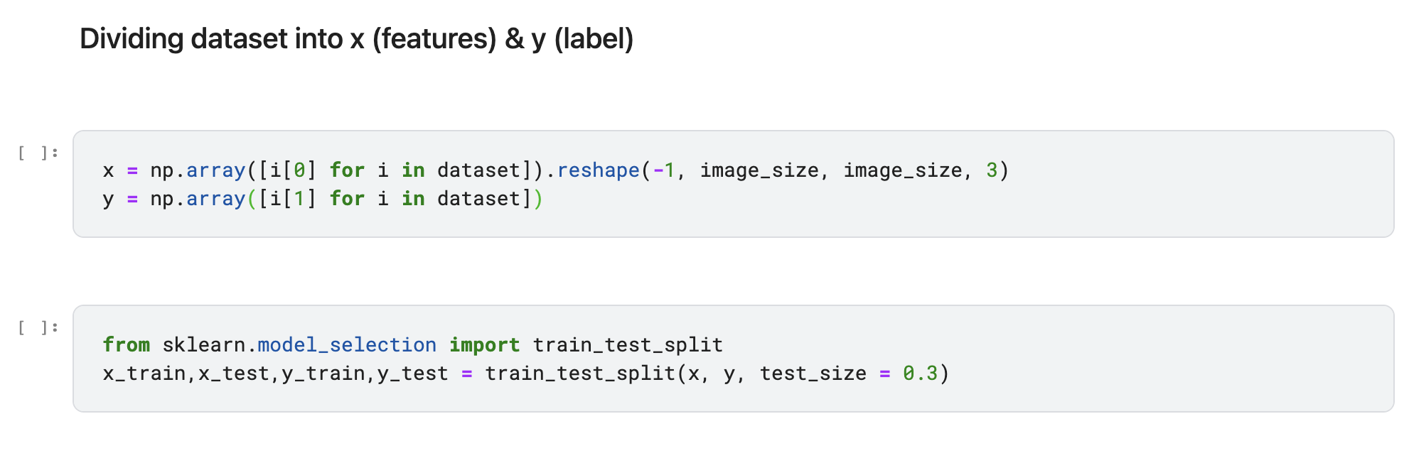
3. Divide the dataset into features (image pixels) and labels (0 = normal, 1 = cataract). After that, do the test-train split on the dataset with test size being 30%.

Slide 6
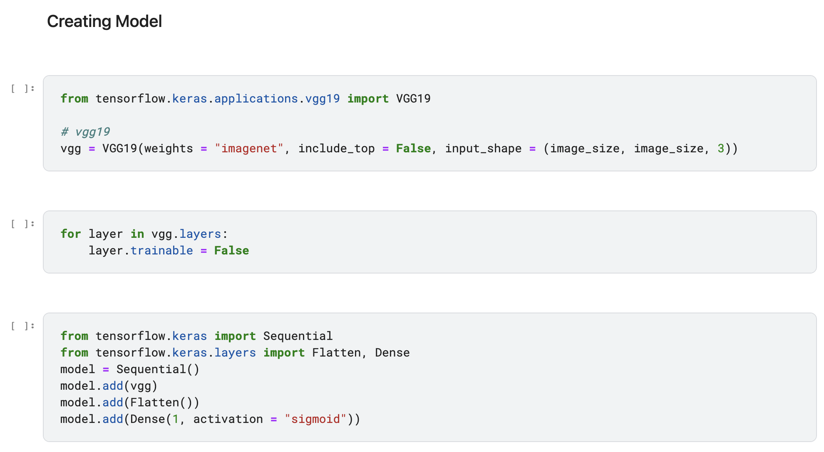
4. Create the CNN model using tensorflow’s pretrained VGG19 imagenet.
5. After that, create a keras sequential model as the main model (CNN) and add the VGG19 model as the first layer. Then, going through, add a flatten layer as the next layer and at last, the dense layer with sigmoid being the activation function.

Slide 7
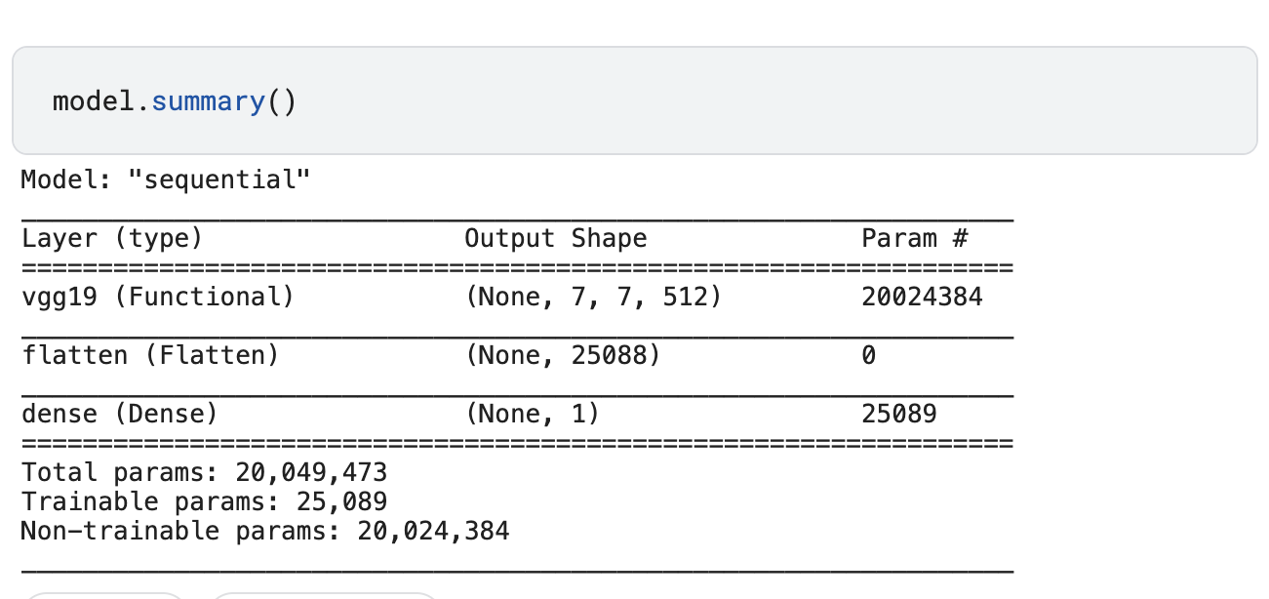
6. After that, I checked out the model’s summary to know about the number of trainable params and output shapes of each layer.

Slide 8
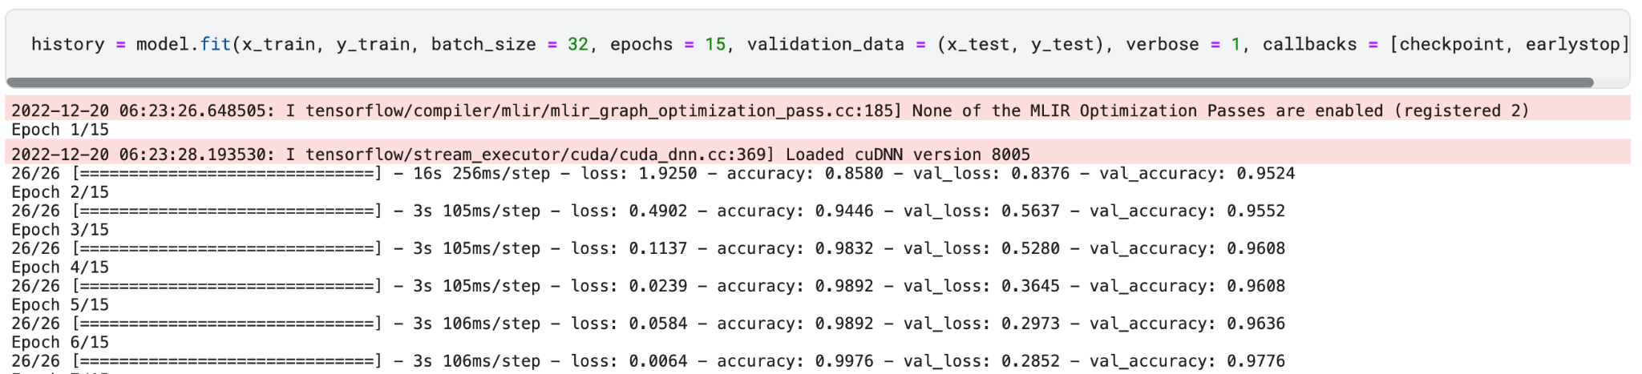
7. Created model checkpoints and early stopping conditions to use while fitting the dataset on the model.
8. Fit the dataset on our CNN model.

Slide 9
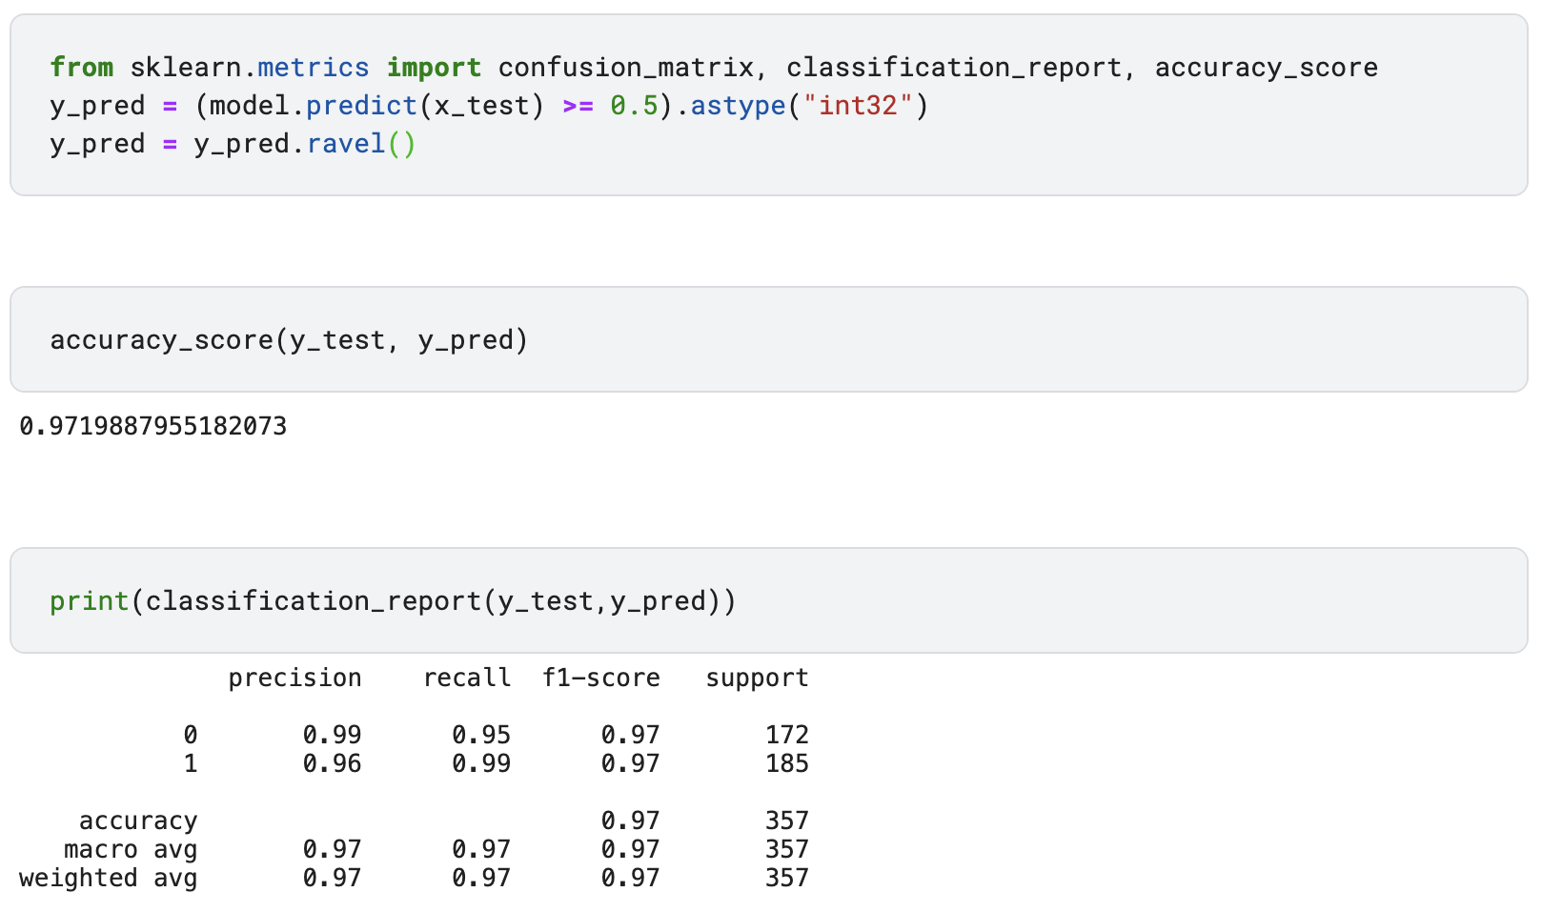
9. Do predictions on the testing data and print the classification report and testing accuracy.

Slide 10
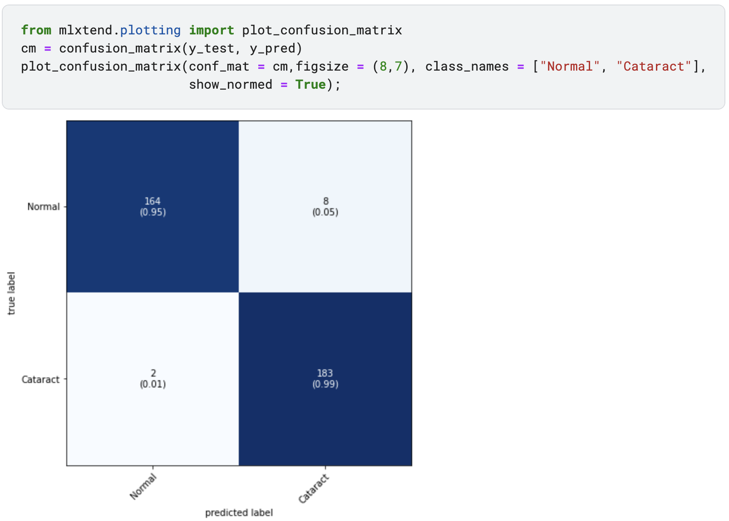
10. Plot confusion matrix and training and testing accuracies and losses

Slide 11
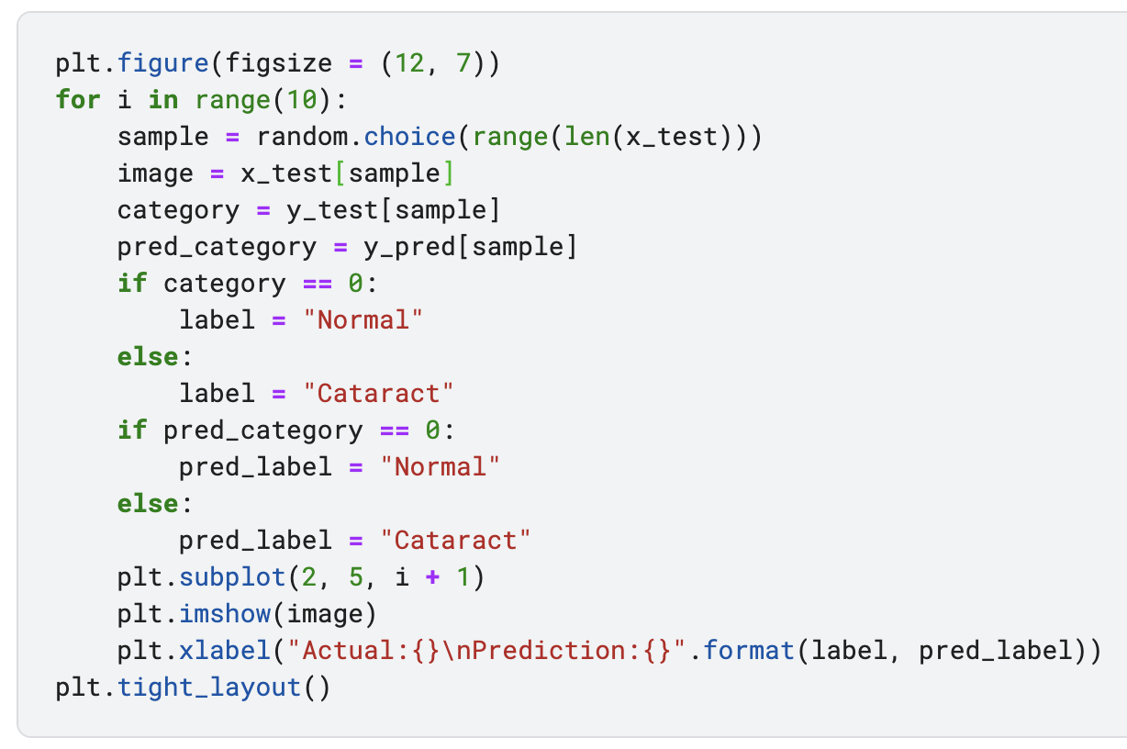
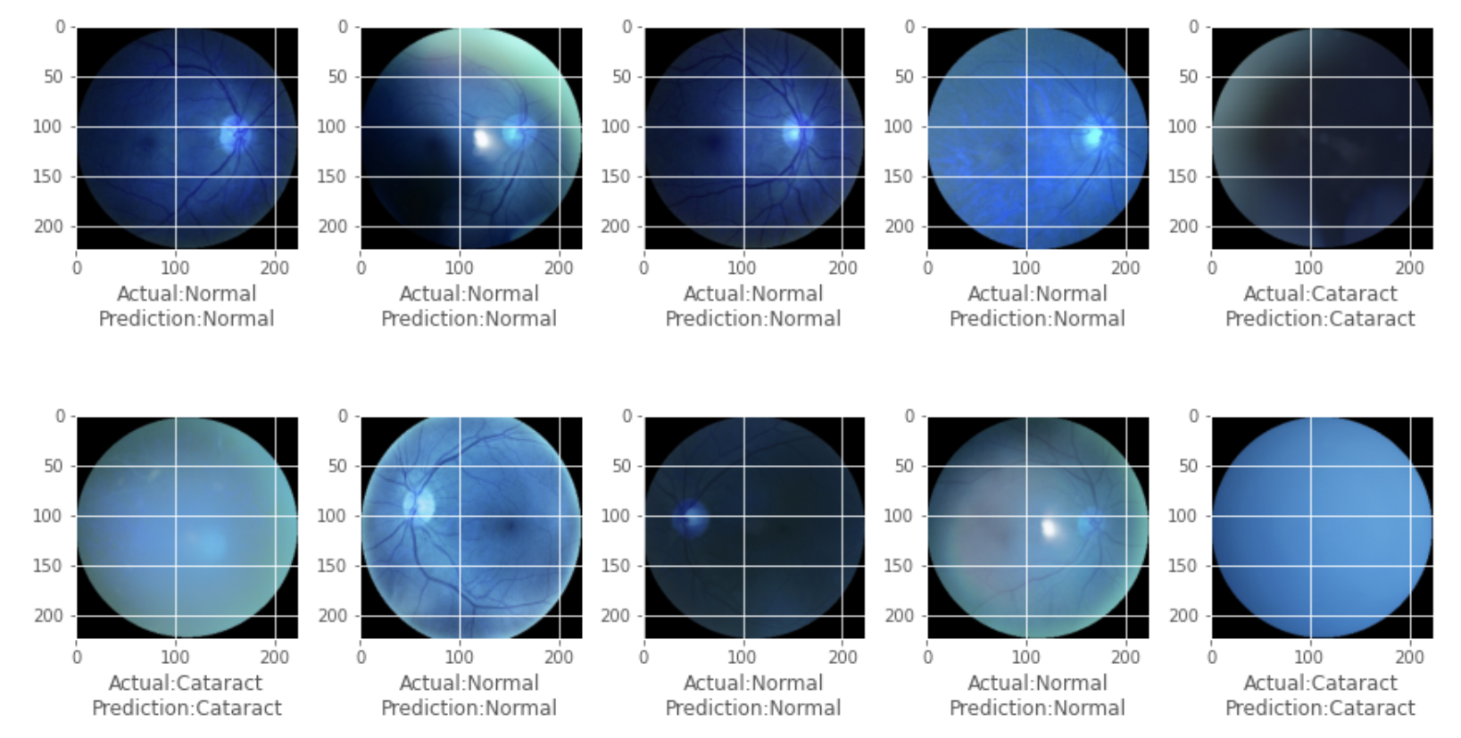
11. Print random comparisons between model results (testing data prediction labels) and true data (testing data actual labels)

Slide 12
THANK YOU!

